Slide 1
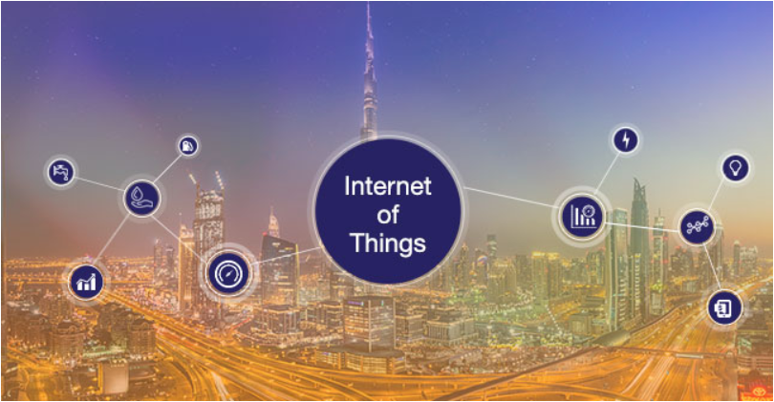
Dhanashree Mane
Sanya Purwar
Harshada Boob
Arjoo Gangwal
Krutika Ambavane

Slide 2
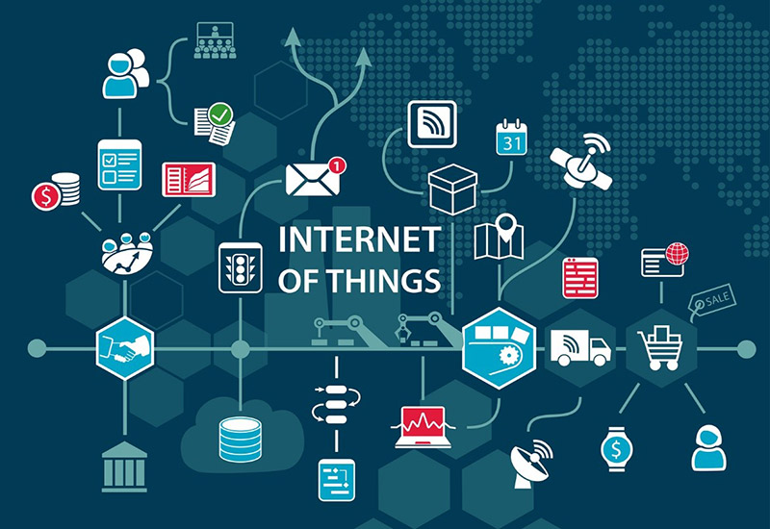
What is IOT?
The Internet of Things(IoT) refers to billions of physical devices around the world that are now connected to the internet and are collecting and sharing data.
"Things", in the IoT sense, can refer to a wide variety of devices. Each thing is uniquely identifiable through its embedded computing system but is able to inter-operate within the existing Internet infrastructure.
The IoT allows objects to be sensed or controlled remotely across existing network infrastructure, creating opportunities for more direct integration of the physical world into computer-based systems.
This results in improved efficiency, accuracy and economic benefit in addition to reduced human intervention.

Slide 3
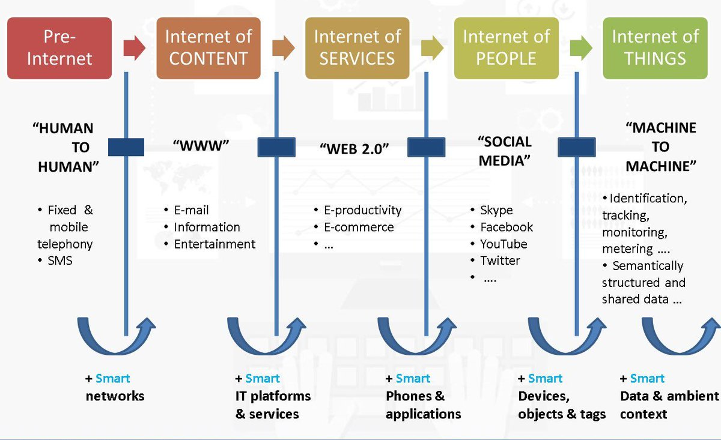
Evolution of IOT

Slide 4
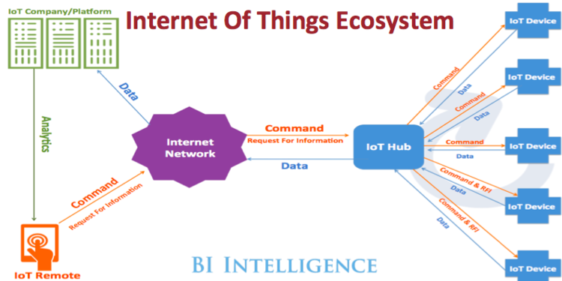
Iot Ecosystem
IoT ecosystem is comprised on an entity (smartphone, tablet, etc) that functions as a remote.
Remote sends a command or request for information over the network to an IoT device.
Once the information is received by the network it sends a command or request for information from the IoT Hub.
The IoT Hub further sends the command to IoT devices
The devices will then perform the command or send information back over the network to be analyzed and displayed on the remote.

Slide 5
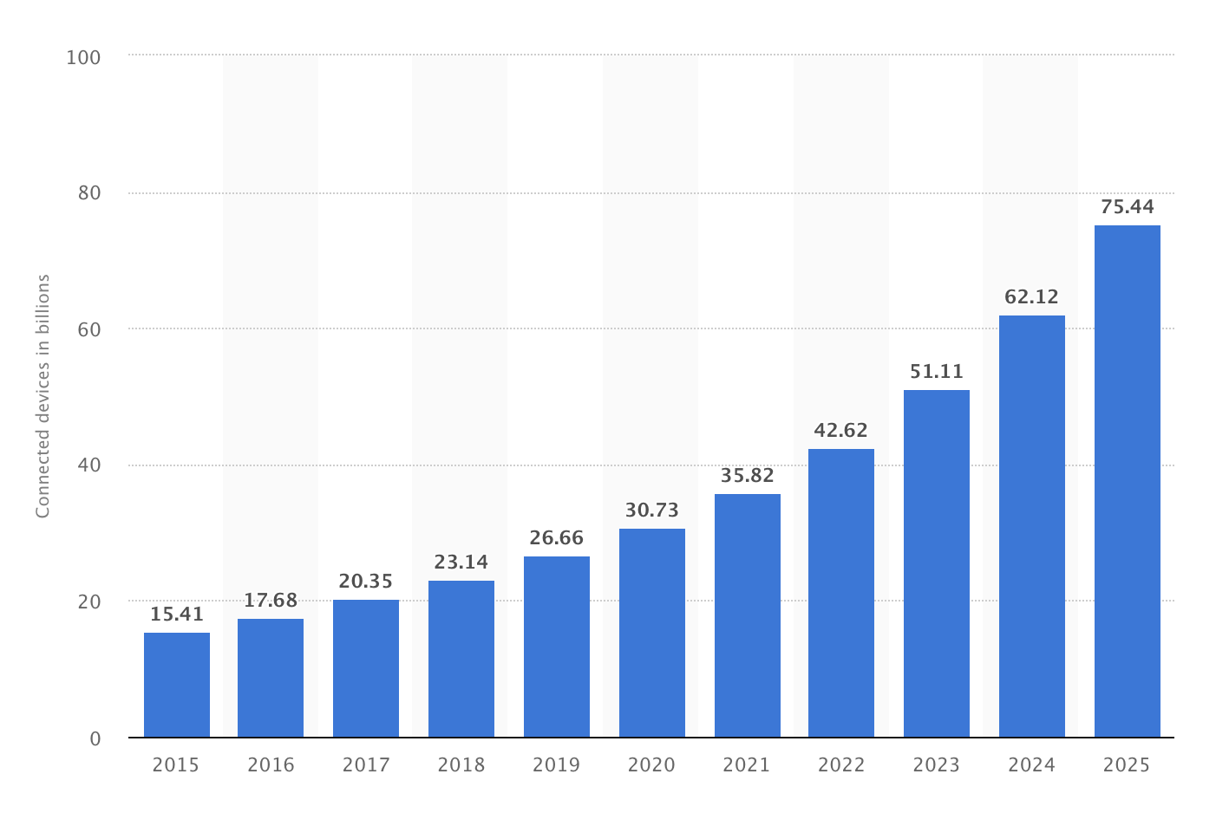
The growth of IOT
As of 2017, 20.35 billion IoT units
Expected to grow to 30.73 billion IoT devices by 2020
Revenue growth from $1.9 trillion in 2013 to $7.1 trillion in 2020

Slide 6
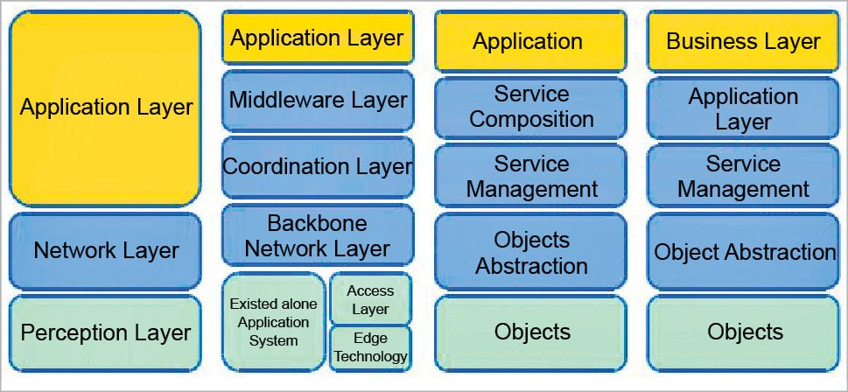
IOT System ARCHITECTURE

Slide 7
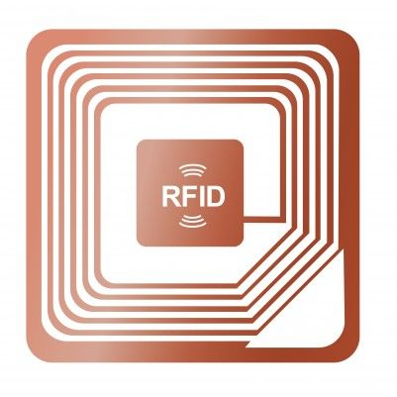
RFID Technology
Radio Frequency Identification
A microchip in a label used to transmit data when label is exposed to Radio waves
Data is transmitted between a reader and a physical item for
Fast
Reliable
Does not require physical contact between reader and the tagged item
Identification
Tracking
What is RFID?

Slide 8
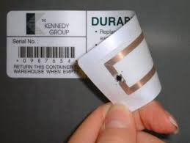
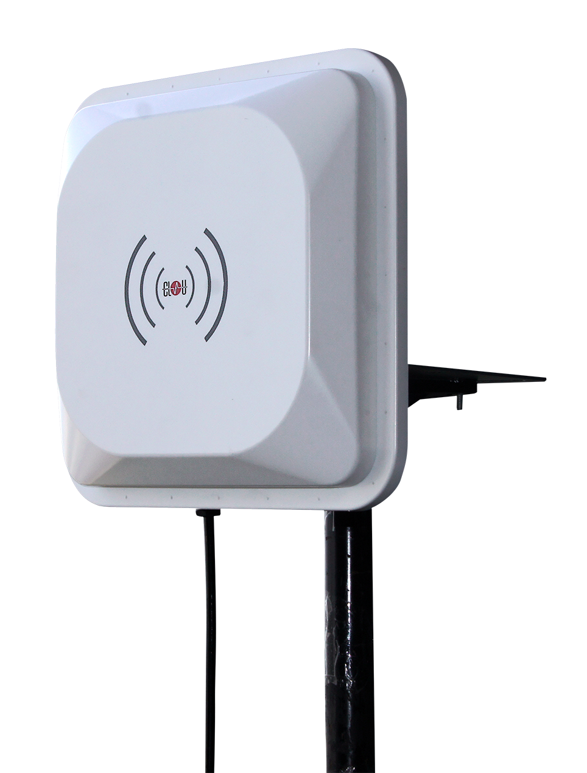
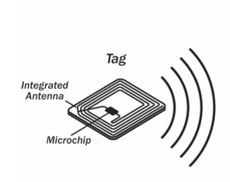
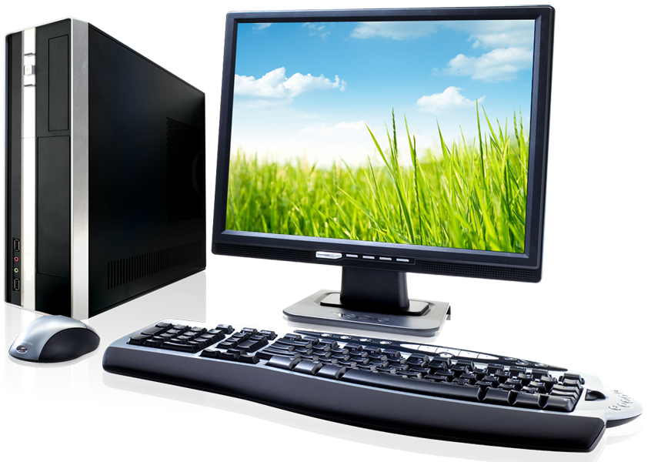
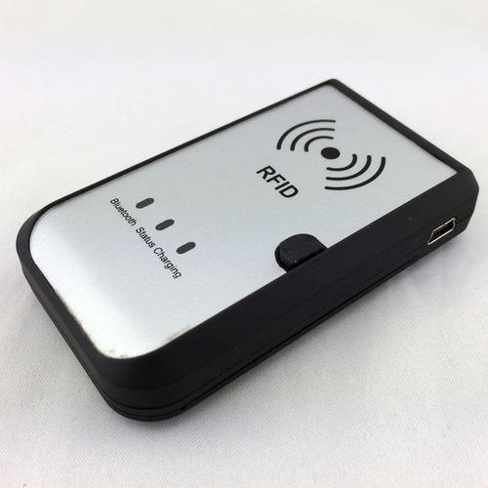
Key components of RFID
What are RFID Tags made of?
Chip – Holds information about the physical object
Antenna – Transmits information to a reader using Radio waves
Packaging – Binds the chip and antenna together so that the tag can be attached to a physical object
RFID ANTENNA
RFID TAGS
COMPUTER
RFID READER

Slide 9
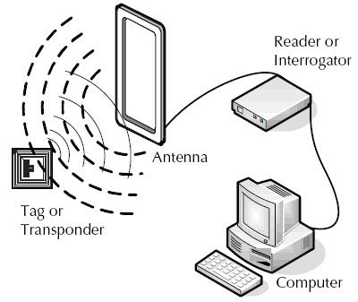
How does RFID work?
Tag holds the information about the physical object
A passive tag is powered by a RFID reader, intermittently from a distance by broadcasting energy to it using the RFID Antenna
The tag then transmits an identifying response
Reader sends information to computer system for collecting, logging or processing.

Slide 10
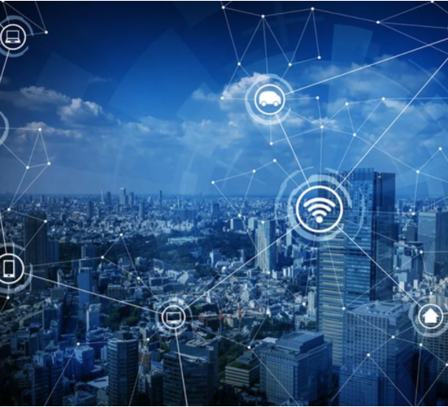
Major tech Challenges
Delivering Value to Customer
Hardware Compatibility Issues
Network & Connectivity Issues
Managing complexity
Security & Privacy

Slide 11
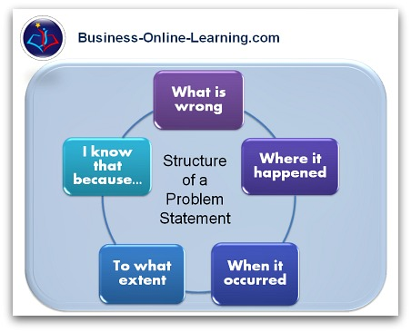
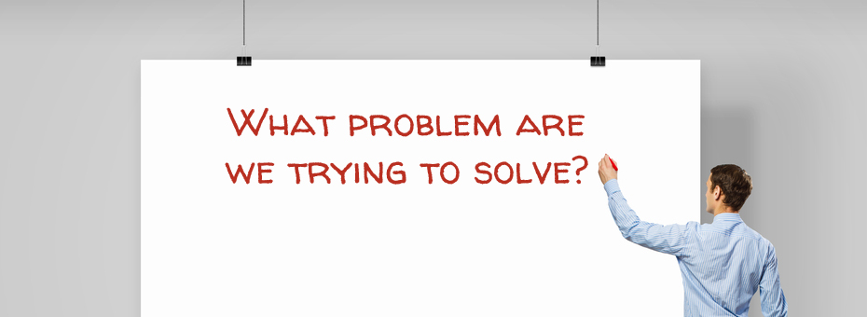
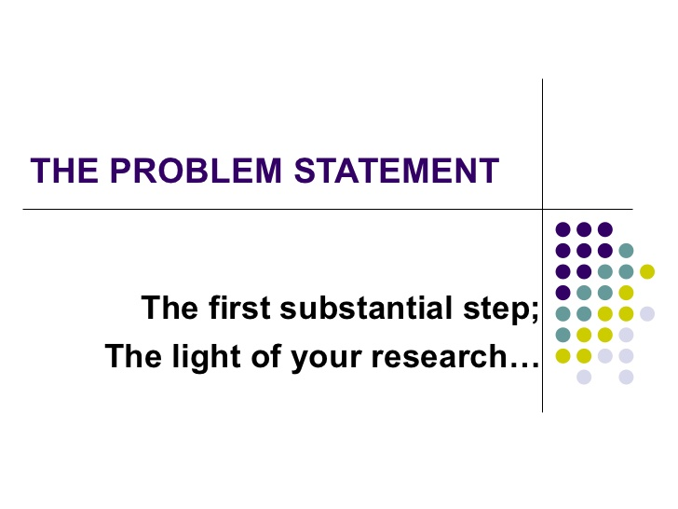
Delivering value to customer
Defining the problem statement clearly.
There cannot be a bigger IoT implementation challenge than this gap of understanding the customer problem statement.
Figure-out the key performance indicators to measure and improve through an IoT solution.

Slide 12
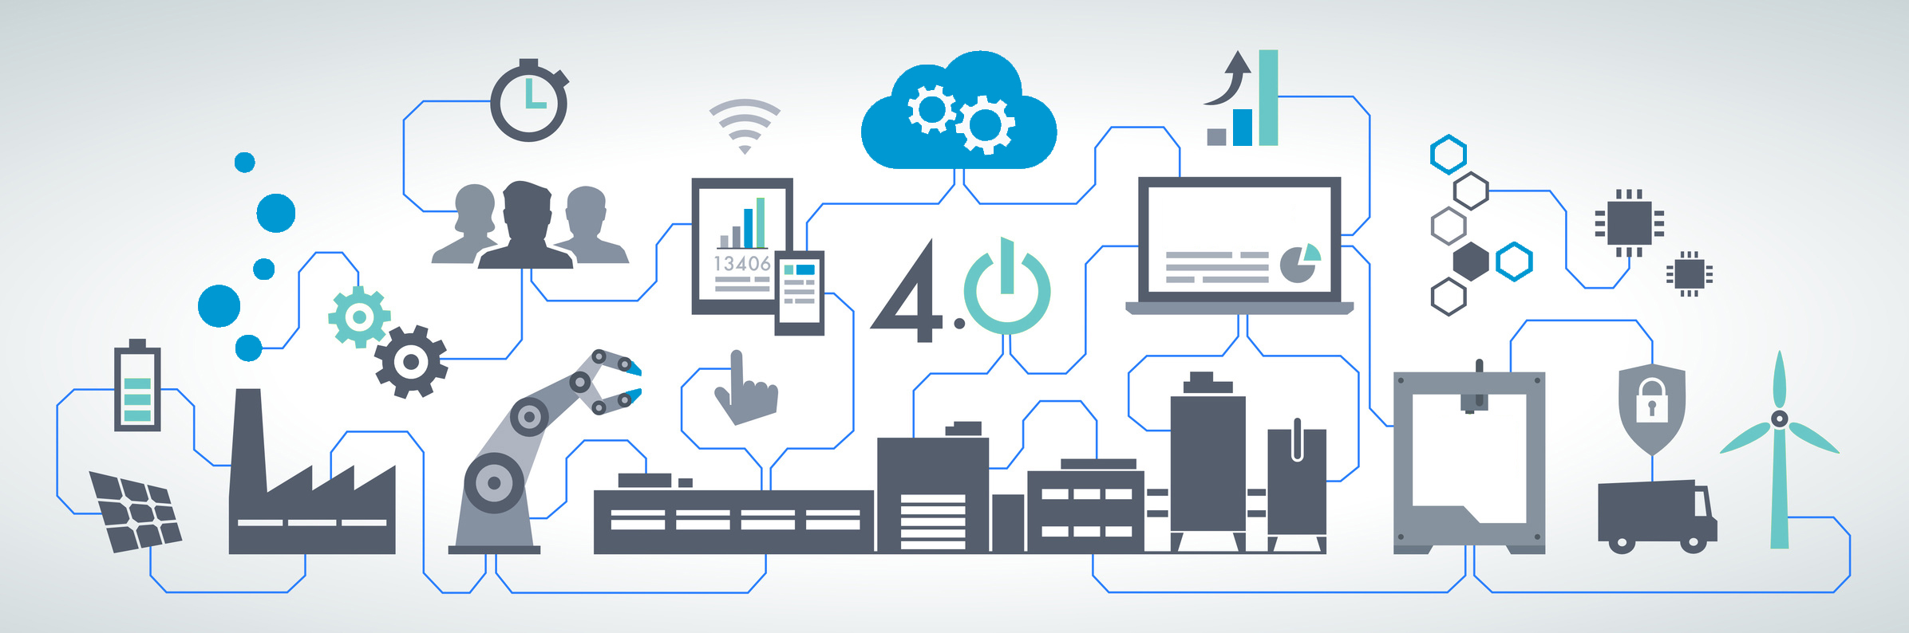
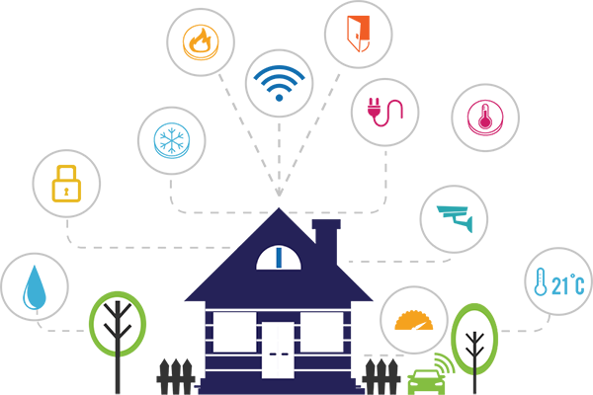
Hardware Compatibility issues
Data capturing majorly occurs through various sensors, PLCs, etc., which are connected to IoT gateways to collect & transmit data to the cloud.
When there are legacy machines that do not have the said PLCs and sensors involved, the IoT implementation challenge becomes more critical.
To have an efficient IoT infrastructure, technology has to be standardized, network protocols, transmission bands, data rate and processing need to be defined and monitored.
IoT devices and networks must be compatible with all conventional transmission technologies

Slide 13
Managing Complexity
Vast number of protocols are used such as BLE, ZigBee, Z-wave, Thread, We-Mo, etc.
In some ways, they are similar; wireless technologies that use mesh networks to wirelessly connect and network IoT devices without involving a cellular or Wi-Fi signal.
No single common standard, companies must determine the right protocol for each use case and ensure the technologies they choose are compatible with their overall platform.

Slide 14
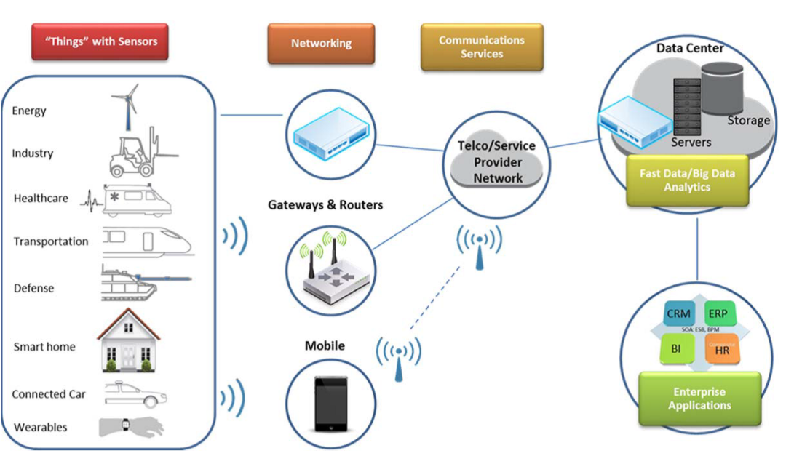
Network & Connectivity
To transmit the signals collected by sensors over networks with all the different components of a typical network including routers, bridges in different topologies, including LAN, MAN and WAN
Difficulty in the implementation of multiple technology platforms is challenging for developers.
How IoT devices talk to the gateway & the Cloud and what data format do they generate.
IoT devices are compatible but legacy devices depend on PLCs, telemetry systems and RTUs to generate data.

Slide 15
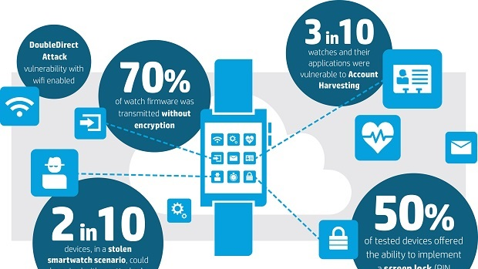
Security & Privacy
Chance of corporate espionage to gain intellectual property.
Host cyber security drills to figure out weakest or unsafe devices.
A comprehensive governance mode, which provides secure access to sensitive reports and data.
Security upgrades are usually implemented by including additional security patches to OS.
When devices connect, they must authenticate, data must be encrypted, and they need to communicate their presence and activity.

Slide 16
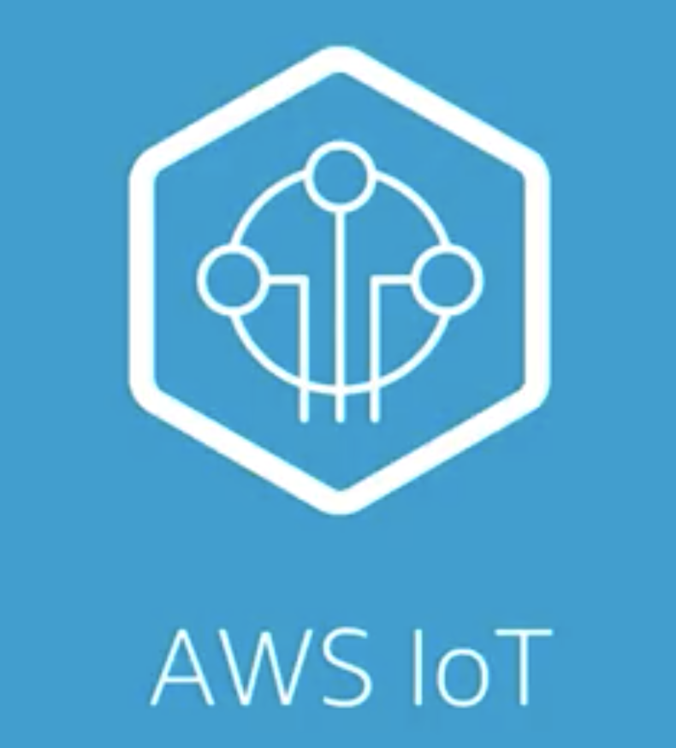


IOT BIG PLAYERS
AMAZON AWS IOT
HITACHI VANTARA
COMCAST MACHINEQ
CLOUD BASED IOT ECOSYSTEM
IOT PLATFORM FOR COMMERCIAL USE
IOT SOLUTIONS FOR HOMES AND BUSINESSES

Slide 17
IoT breakthrough award
Recognizes innovative technologies & the companies that are driving these innovations
James Johnson- Managing Director
3000 nominations
IoT industry experts judges
Award won by Hitachi Vantara
“In God We Trust. All Others Must Bring Data.” – W. Edwards Deming, Statistician, Professor, Author

Slide 18
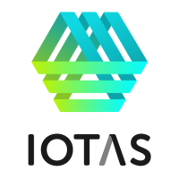
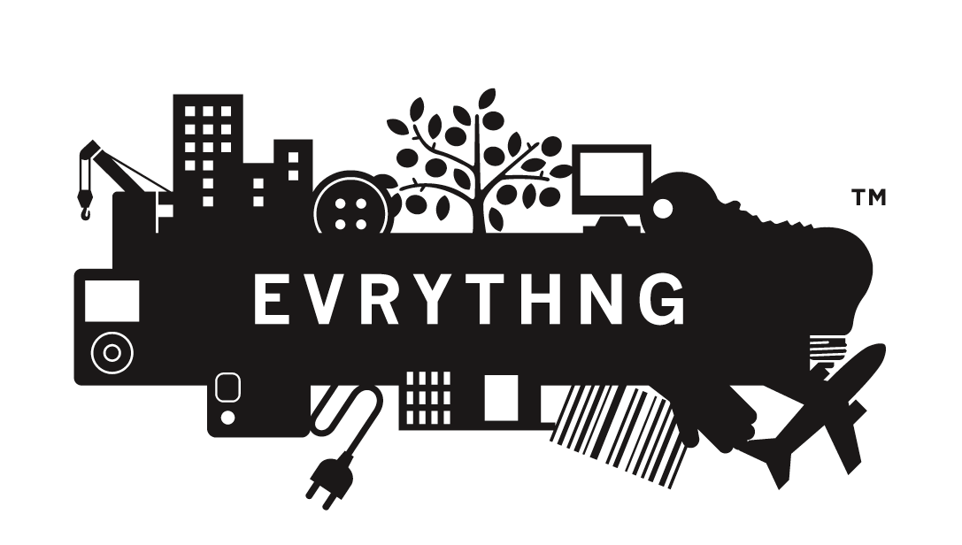
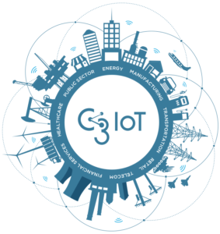
IOT BIG STARTUPS
IOTAS
EVRYTHNG
C3IOT
SMART HOME FOR RENTERS
IOT CLOUD PLATFORM
DIGITAL ENTERPRISE FOR IOT

Slide 19
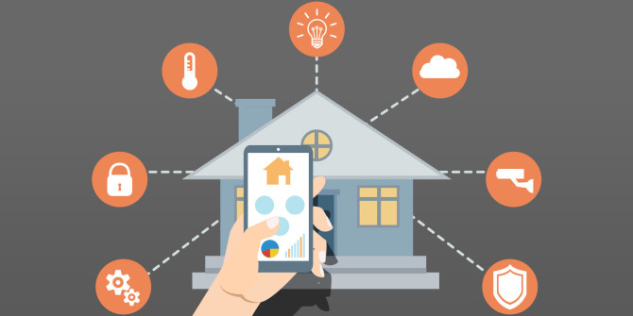
IOTAS THE SMART APARTMENT
Portland based startup founded in 2014
Funding : $6.9m
Connected smart home device company
Partners with property developers
CES Innovation Award in 2017
Full product roll-out expected in this year

Slide 20
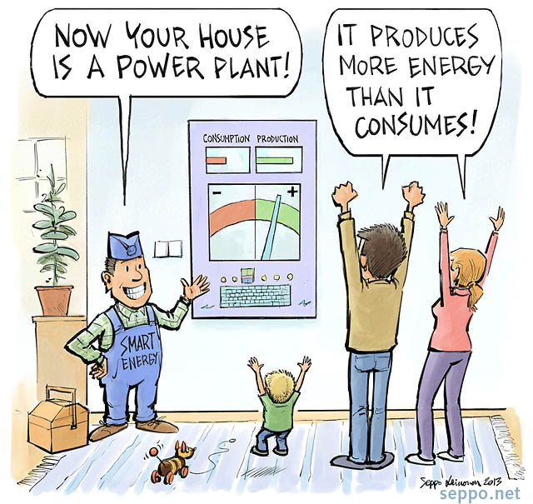
IOTAS THE SMART APARTMENT
Offers
IOTA hubs
Smart switches
Smart outlets
Door sensors
Motion sensors
Smart thermostat
Integrates with IOT products such as Amazon Echo, Nest.
Energy and utility bills savings
Autopilot mode available
Provides pre-defined list of daily routines to choose from

Slide 21
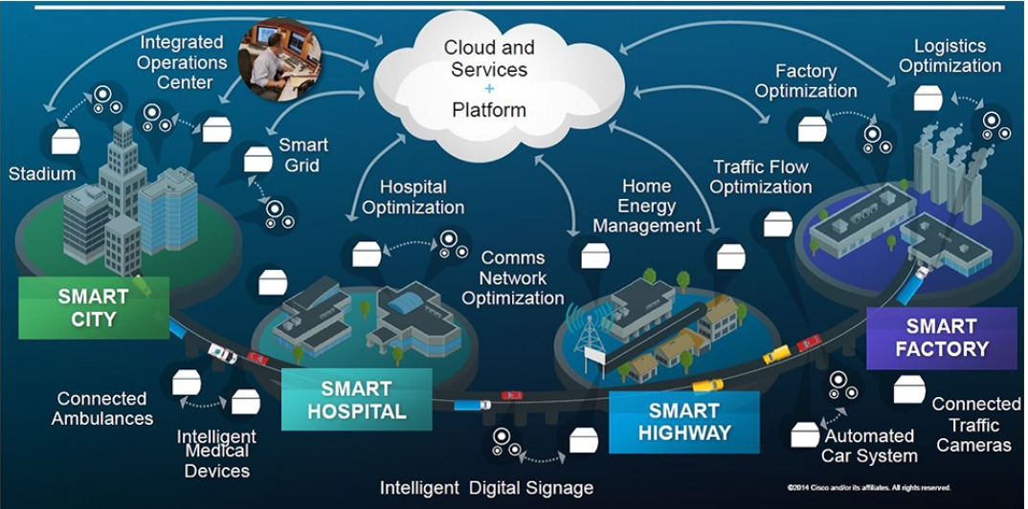
Commercial applications

Slide 22
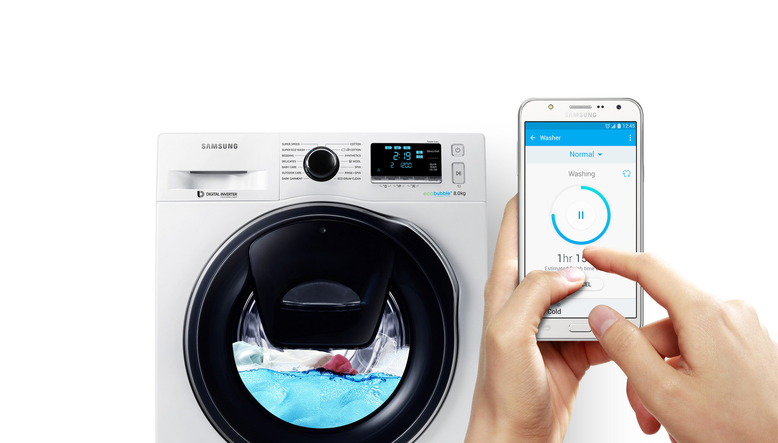
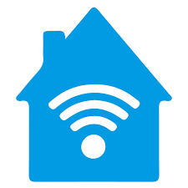
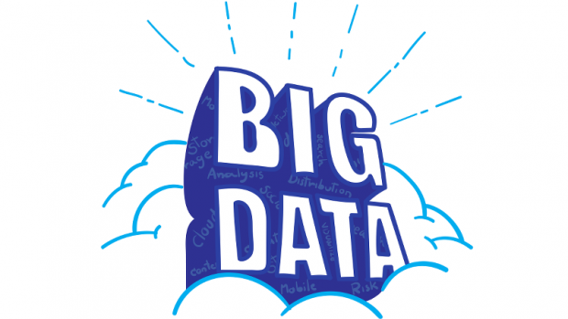

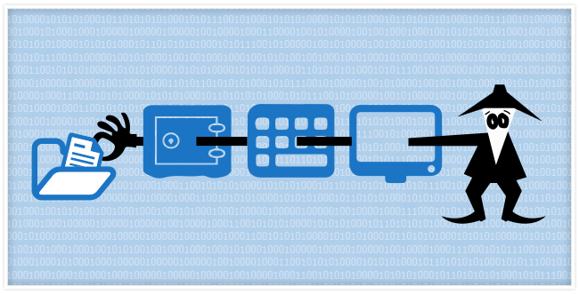
Is it practical ?
Yes, it is practical and in use too. But it comes with a few downsides –
Proprietary protocols –
Internal communication issues
Privacy concerns –
Big data warehousing and security
Safety worries –
Gatecrashing your smart home
?

Slide 23
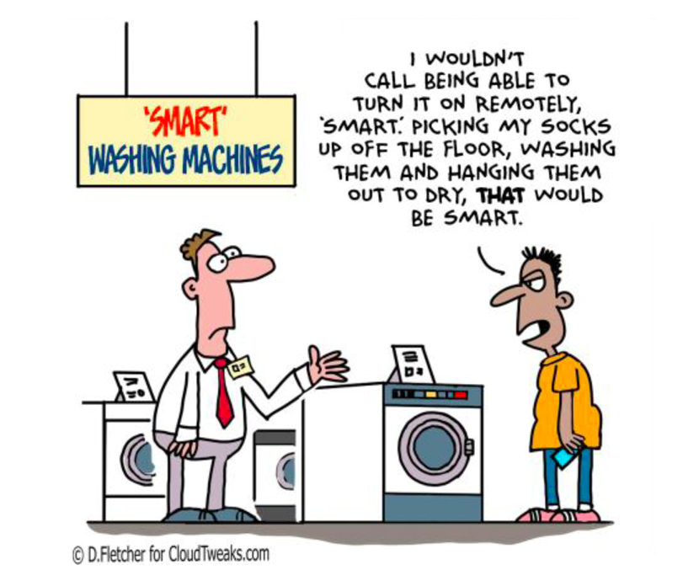
FUTURE SCOPE

Slide 24
References
https://iot-analytics.com/10-internet-of-things-applications/ https://www.smarthomeusa.com/smarthome/
https://codeburst.io/3-challenges-of-iot-adoption-and-how-enterprises-can-overcome-them-b17be965d878
http://www.saviantconsulting.com/blog/iot-implementation-challenges-enterprises.aspx
https://www.analyticsvidhya.com/blog/2016/08/10-youtube-videos-explaining-the-real-world-applications-of-internet-of-things-iot/
https://datafloq.com/read/internet-of-things-more-than-smart-things/1060
https://electronicsforu.com/technology-trends/popular-iot-protocols
https://en.wikipedia.org/wiki/Internet_of_things
http://www.abr.com/what-is-rfid-how-does-rfid-work/
https://www.rfpage.com/challenges-in-internet-of-things-implementation/
https://datafloq.com/read/internet-of-things-more-than-smart-things/1060
https://www.forbes.com/sites/insights-hitachi/2017/12/18/4-ways-to-overcome-the-complexity-of-iot-implementation/#699239977034

